Slide 1
Travel Rating Analysis with Clusters Shoto Fukuda
Notes:
_

Slide 2
Project analysis slide 2
Outline
Problem
Methods
Results
Conclusion
Discussion

Slide 3
Project analysis slide 2
Problem
The technology of the Tourism industry
Million reviews on several websites
Everyone has different travel preferences
GOAL: Help people decide to select destinations
Notes:
I choose travel topic because I always look at the internet and get information to find what activities, shopping malls, and restaurants are suitable for that place. There are so much information and reviews on travel website and social media. Most of the time, websites tell you the top 10 places you should visit. For example, when I searched about Disney World, they showed the top 10 attractions you should try. However, if they like the roller coaster, the ranking is excellent. The top 10 ranking chart is useless if people dislike roller coasters. Everyone has a different preference, so my study will analyze the user's travel preferences to find travel patterns, and this study will help people decide when selecting a travel destination.

Slide 4
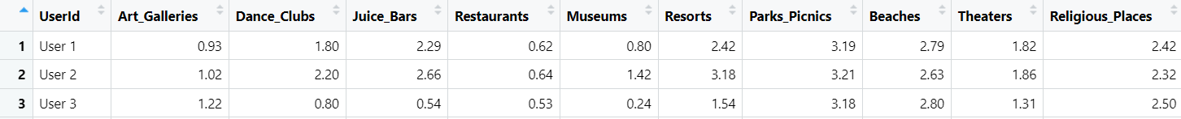

Project analysis slide 2
Dataset
TripAdvisor.com (the University of California Irvine)
Reviews of destinations in 10 categories across East Asia
980 unique user-id
Excellent (4), Very Good (3), Average (2), Poor (1), and Terrible (0)
Notes:
Tripadvisor collects my dataset. The dataset has Unique-user ID and ten categories in East Asia. There are 980 users, and Each traveler rating is mapped as Excellent (4), Very Good (3), Average (2), Poor (1), and Terrible (0), and an average rating is used against each category per user.* Some users may visit four or two museums in East Asia.
The dataset does not provide the information such as the user’s I chose this dataset because I could find the different preferences to make a cluster.
There is no missing value in this dataset.
The average rating is used against each category per user.
divided into groups

Slide 5
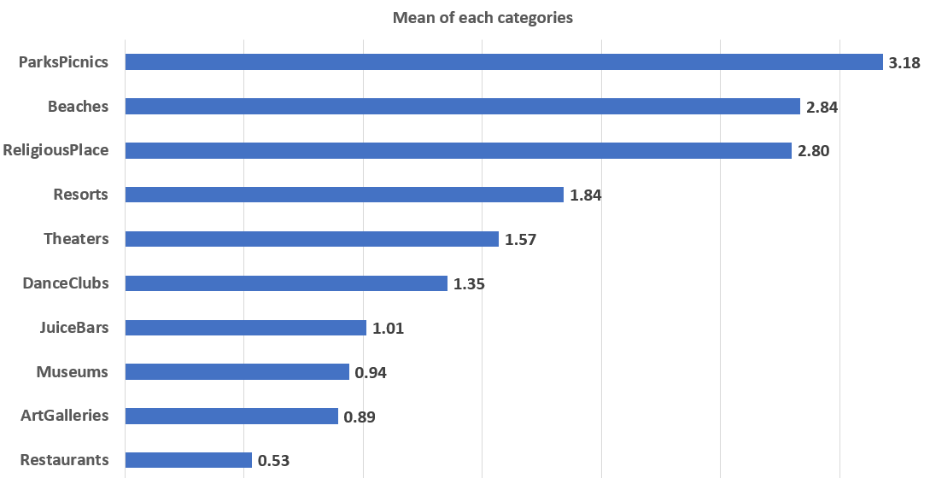
Project analysis slide 2
Descriptive statistics
(Variance)
(0.006)
(0.0189)
(0.1032)
(0.2911)
(0.1329)
(0.2287)
(0.6219)
(0.1913)
(0.1068)
(0.07825)
Notes:
By the dataset, this is the average rate review of each category, we can see the park pick, beach, and religious are popular, and the restaurants, art galleries, and museums are most popular in East Asian.
My study will identify hidden patterns or structures in the data that may not be seen by using descriptive statistics

Slide 6
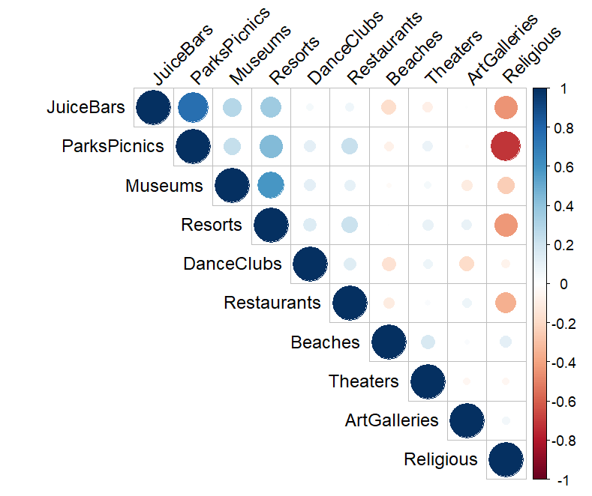
Project analysis slide 2
Personal Correlation
Positive correlation between Juice Bars and Park Picnics
Negative correlation between Religious and Park Picnics
0.75
-0.71
Notes:
I may not show this slide

Slide 7
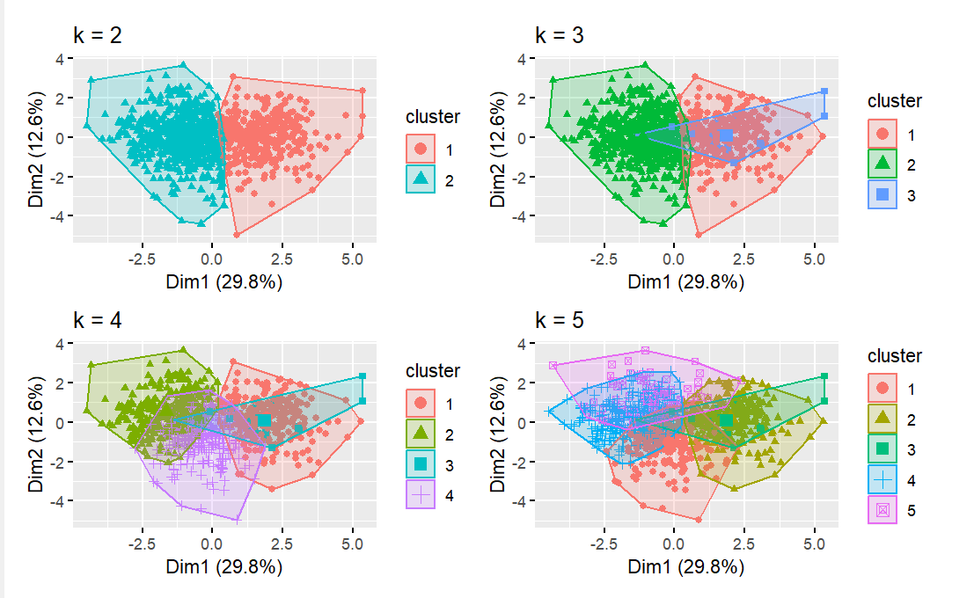
Project analysis slide 2
K-mean method
Assumption
All variables have the same variance
Notes:
The first assumptions are that all variable have the same variance. The second one is when I divide by the groups; each cluster has roughly the same equal number of observations. The difficulty of this project is visualization of the chart
Ex

Slide 8
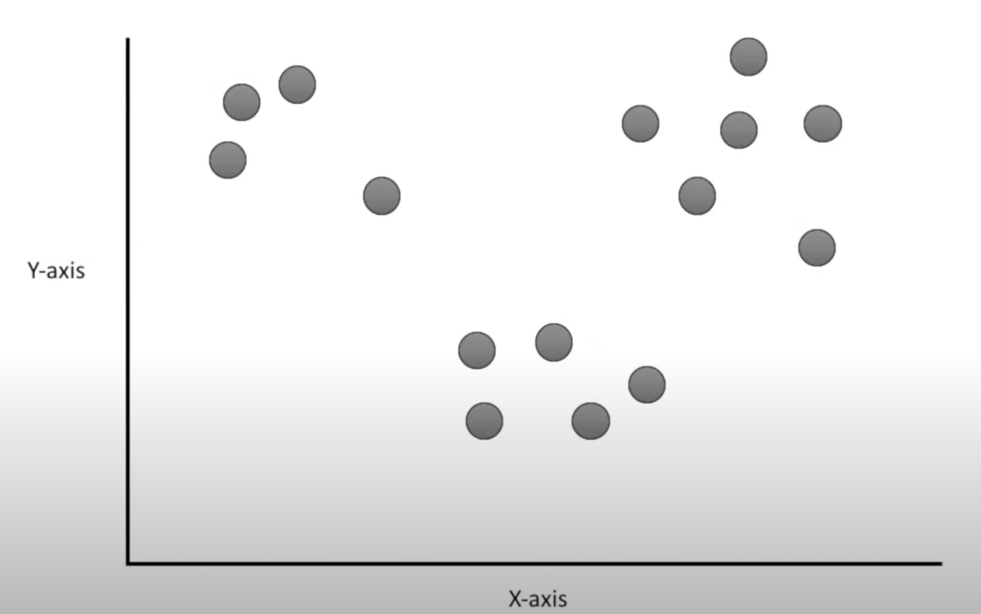
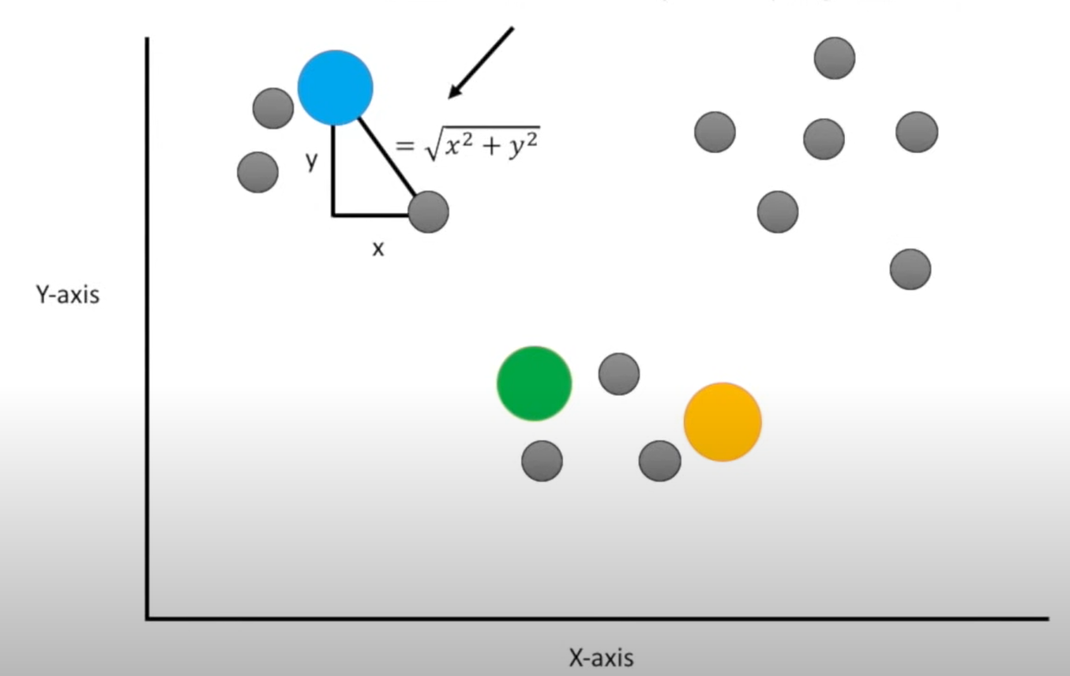
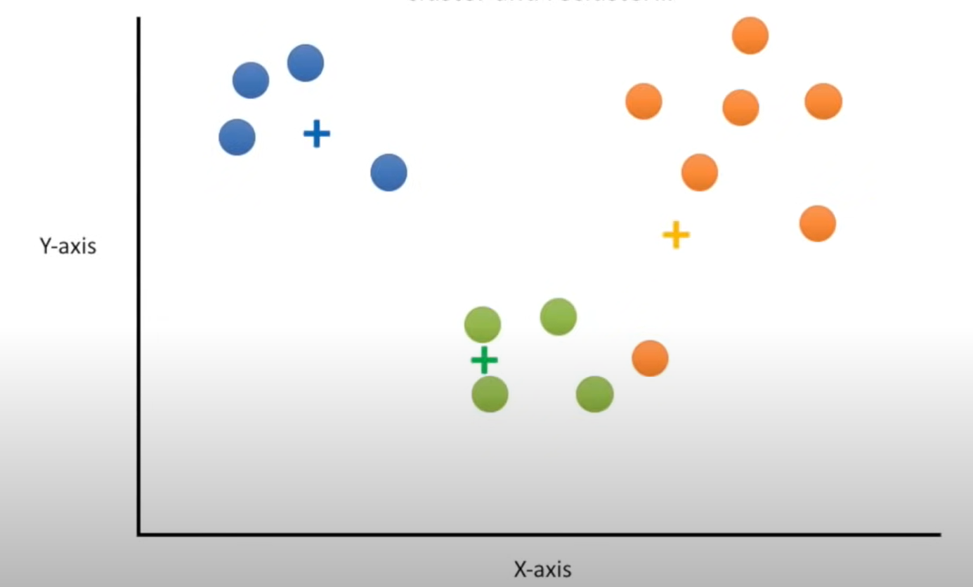



Project analysis slide 2
Cluster Analysis Method
Elbow method, Average silhouette width, GAP Statistic
k-means clustering by the users
->Find the centroid of the cluster
->Assumption- All variables have the same variance.
Notes:
I will mainly use R and Excel to clean data and analysis. Elbow method, Average silhouette width, GAP Statistic method tell the best number of clusters.
I will use the cluster method, which is divide the dataset into groups based on similarity. The similarity means that my dataset is
First, you choose the number of clusters you want to create (k).
Then, you randomly select k points from your dataset to serve as the initial centroids for each cluster.
Next, you calculate the distance between each point in the dataset and the centroids of each cluster. The point is assigned to the nearest centroid.
Once all the points are assigned to a cluster, you calculate the mean of all the points in each cluster, and use that as the new centroid for that cluster.

Slide 9
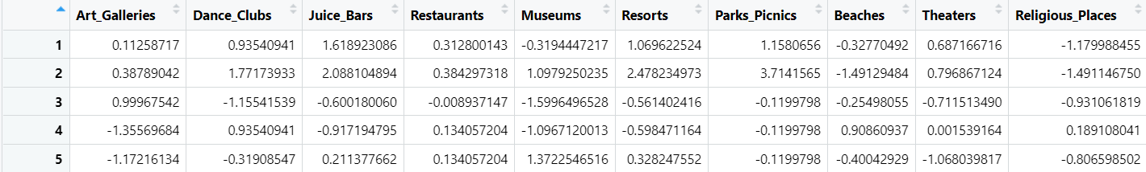
Project analysis slide 2
Data cleaning
Applied the scale function to the dataset
-> Mean is 0 & Standard deviation is 1
Variance each category

Slide 10
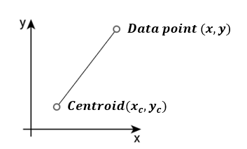
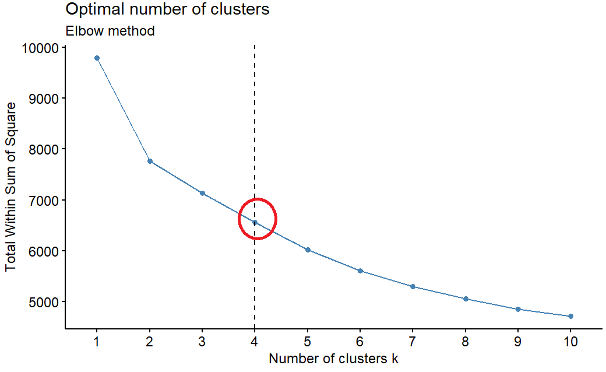
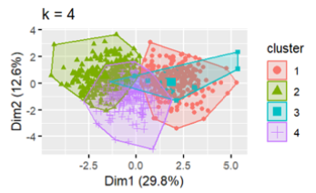
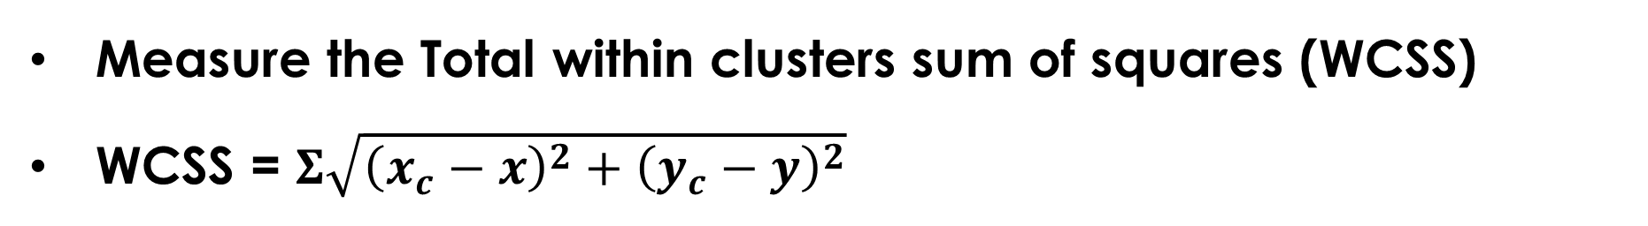
Project analysis slide 2
Elbow Method
Measure the Total within clusters sum of squares (WCSS)
WCSS = $Σ\sqrt{{\left(x_{c}−x\right)}^{2}+{\left(y_{c}−y\right)}^{2}}$
Notes:
For each value of k, you calculate the sum of squared distances between each point and its assigned centroid. This is a measure of how spread out the data is within each cluster.
You plot the values of the sum of squared distances for each value of k on a line graph.
The best point tends to change slowly and remain less changing as compared to other k’s

Slide 11
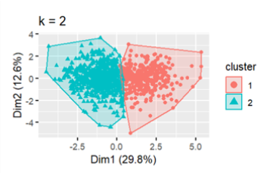
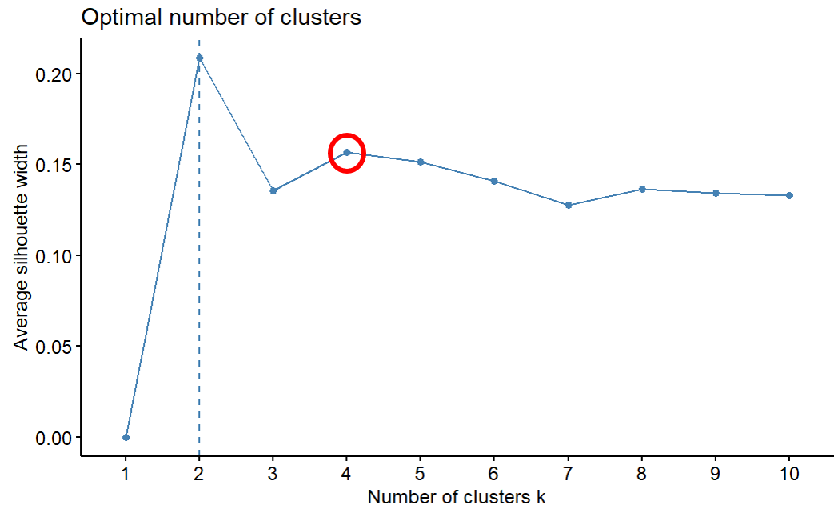
Project analysis slide 2
Average silhouette width
Measuring the quality of a clustering
High average silhouette width indicate a good clustering
Notes:
A high average silhouette width indicates good clustering.
The average silhouette width method measures how similar that observation is to its own cluster compared to other clusters.
The following code computes this approach for 1-10 clusters. The results show that 2 clusters maximize the average silhouette values, with 4 clusters coming in as the second optimal number of clusters.

Slide 12
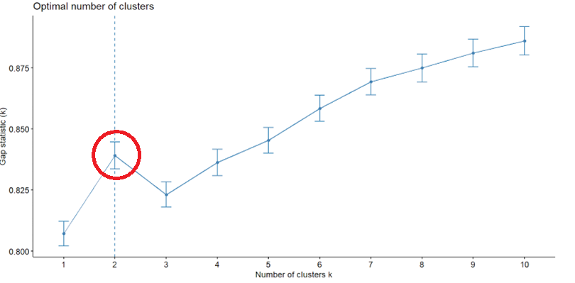
Project analysis slide 2
GAP Statistic
Monte Carlo simulations generate the dataset
Compared original log(WCSS) and expected log(WCSS)
WCSS = Total within clusters sum of squares

Slide 13
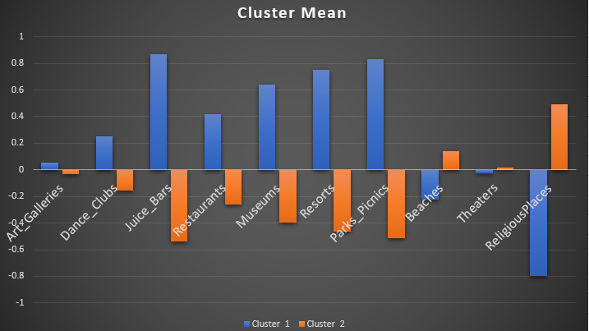
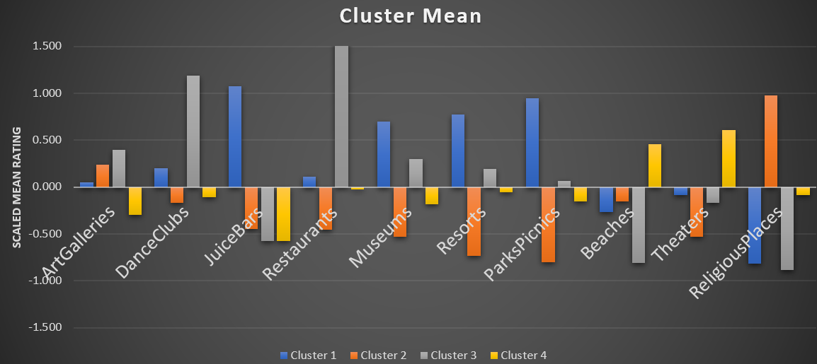
Project analysis slide 2
2 & 4 clusters models
Notes:
Average of the user rate by cluster
Scaled from 0 to 1. positive is good and negative is bad

Slide 14
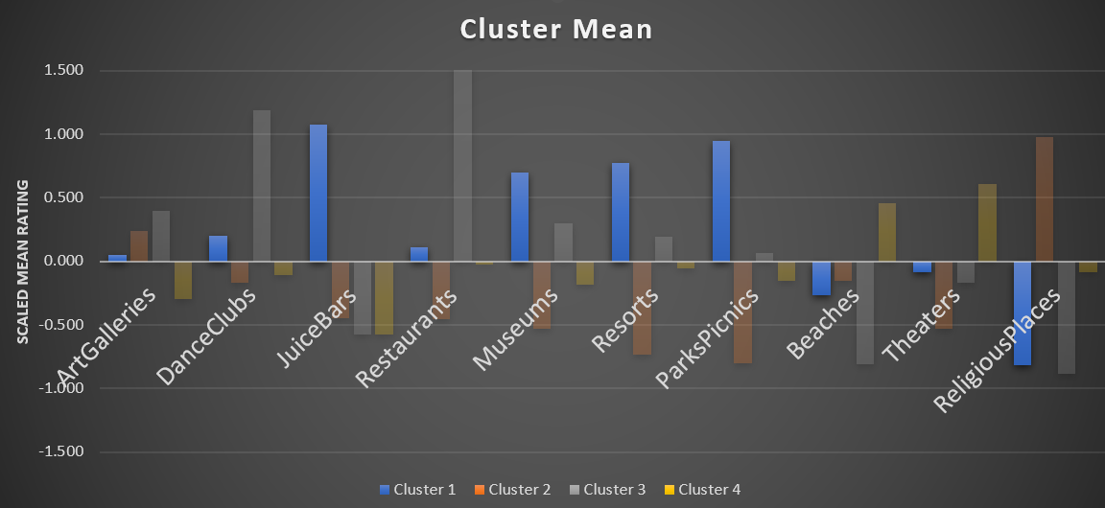
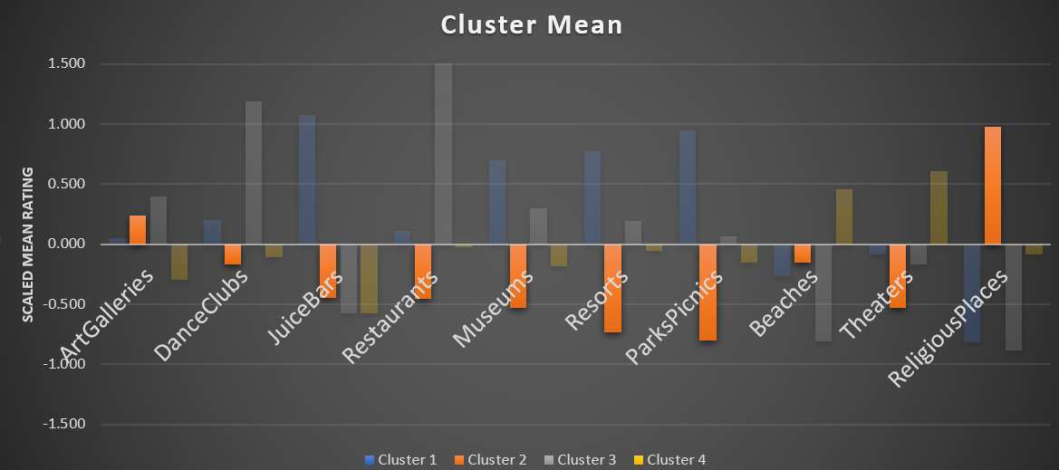
Project analysis slide 2
4 clusters
Cluster 1
Cluster 2
Enjoy: Juice bars, Museums, Resorts, and park picnic
Enjoy: Art Galleries
and Religious Places
Notes:
In the results of the final model analysis, we found that we can divide the users in the data into four groups. People who want to enjoy staying at resorts for leisure or vacation and are not interested in religion are assigned to group 1. We recommend Juice bars, park pickings, and museums. However, you may not find the great beaches around resort areas in East Asia. The dataset does not include the locations of the resorts and beaches, so we assume this. People who want to visit the religious places are assigned to group 2. We recommend you visit the Art galleries place instead of the Museums. We cannot tell the exact difference between Art galleries and museums. People in this group tend not to be interested in the park picnic. People who want to enjoy drinking and the dance club at night are assigned to group 3. We recommend that you visit the restaurant and art gallery. The dataset does not include age information, so we can only assume this group people young generation people because only this group has favorable review rates for the dance clubs. If your time is tight for the travel, we do not recommend religious, beaches, or juice bars to the group 3. People who want to go to the lovely beach and relax are assigned to group 4. we recommend visiting the theater. We do not recommend the juice bars and art galleries if your time is tight for the travel.

Slide 15
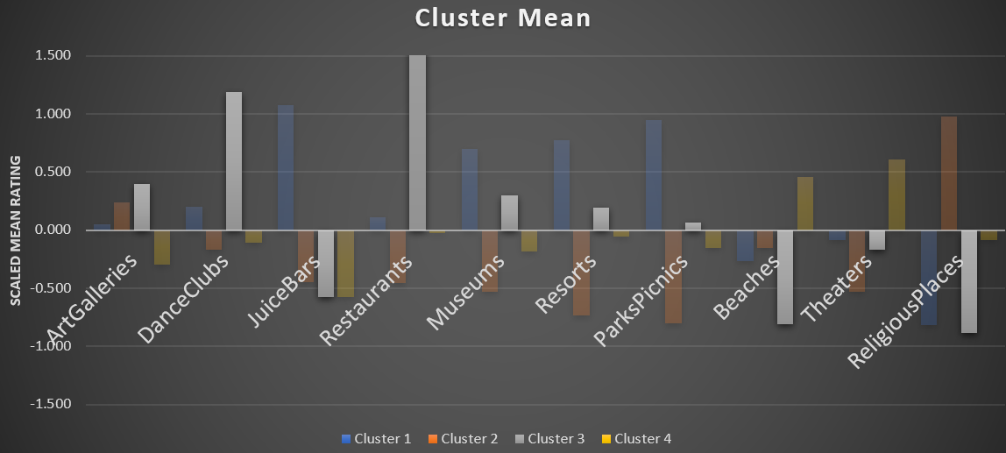
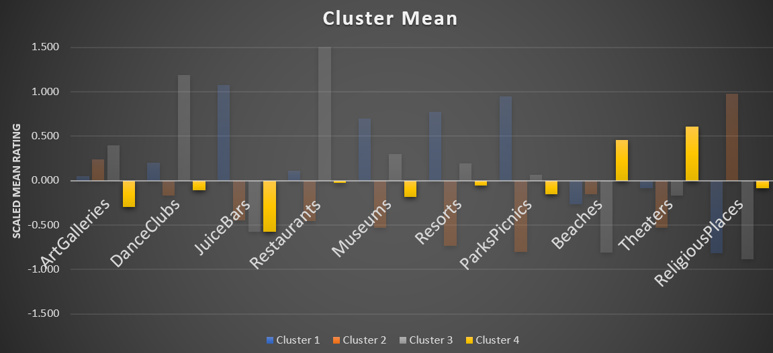
Project analysis slide 2
4 clusters
Cluster 3
Cluster 4
Enjoy: Dance Club and Restaurants
Enjoy: Beaches and Theaters
5.6

Slide 16
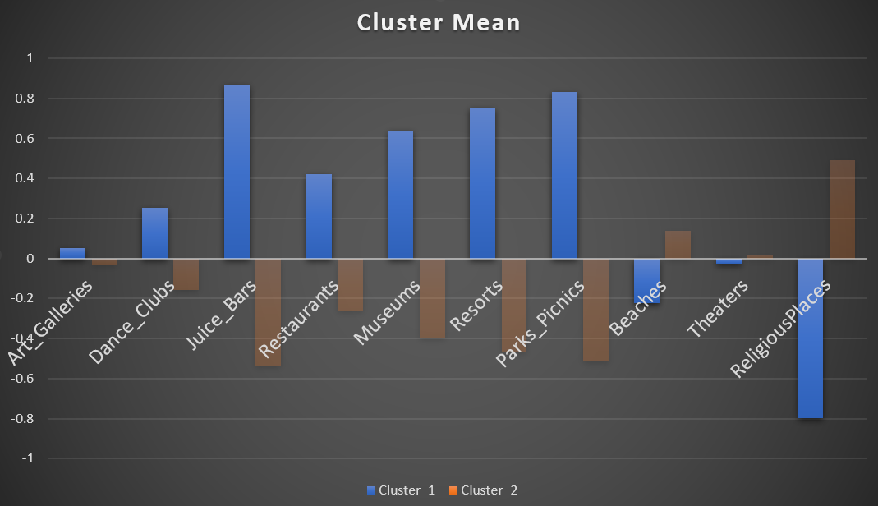
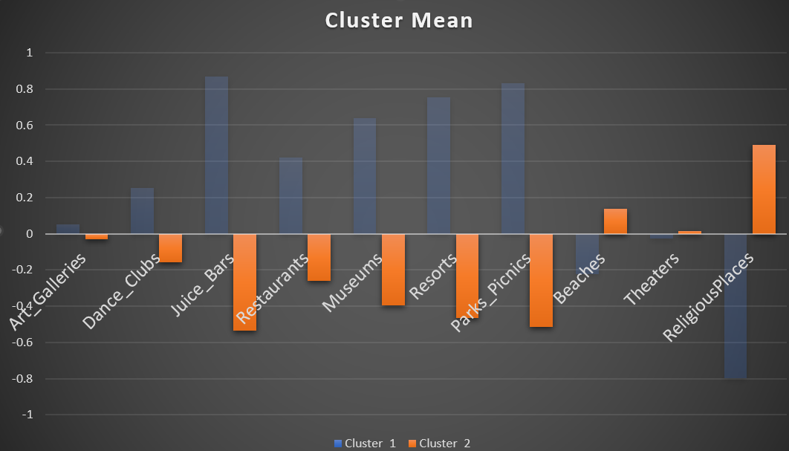
Project analysis slide 2
2 clusters
Cluster 1
Cluster 2
Enjoy: Resorts, Museums, Juice bar, Park picnics
Enjoy: Religious and beach

Slide 17
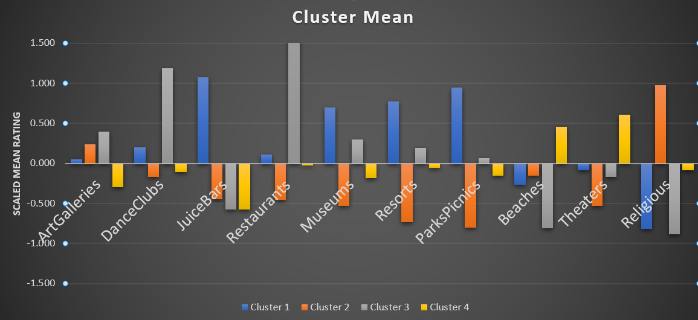
Project analysis slide 2
Final Model
Average of the user rate by cluster
5.6

Slide 18
Project analysis slide 2
Conclusion
4 cluster is the best model for the dataset
 | Cluster 1 | Cluster 2 | Cluster 3 | Cluster 4
Enjoy | Resorts Juice bar Park Picnic Museums | Religious Places Art Galleries | Restaurants Dance Clubs Museums | Beaches Theaters
Not Recommend | Religious Places | Resorts Park Picnic | Religious places Beaches Juice Bar | Juice bar Art Galleries
Notes:
This paper presents a cluster analysis of the travel review rate in East Asia. We use the K- mean cluster method to identify the similarity and dissimilarities of the user’s travel preference. We applied several methods to determine the best number of clusters. The analysis results show that each cluster of people has different travel preferences and the main purpose of visiting East Asia. This study will help people when the people select the travel destinations in East Asia in the future. Hierarchical Clustering is another method to generate clusters to identify the difference in the user's reviews. Cluster analysis is good for identifying hidden patterns and structures such as behavior, demographics, preferences, or purchasing patterns. Our dataset does not include the locations of each category, so we cannot recommend user-specific sightseeing locations. Therefore, we can only recommend East category activities to the users.
@@ This study applied to only East Asia because the dataset has only east !!

Slide 19
Project analysis slide 2
Discussion
Cluster analysis is good for identifying the hidden patterns and structures in the dataset
-> behavior, demographics, preferences, or purchasing patterns
If the dataset has missing values, data cleaning, and another method will be required
Other methods: Hierarchical clustering & Cosine Similarity

Slide 20
Project analysis slide 2
Reference
Cincinnati, U. o. (n.d.). K-means Cluster Analysis. Retrieved from UC Business Analytics R Programming Guide: https://uc-r.github.io/kmeans_clustering
Dhendra, M., Sunarna, H. H., & Wijaya, E. (2018). The Determination of Cluster Number at k-Mean Using Elbow Method and Purity Evaluation on Headline News. In 2018 International Seminar on Application for Technology of Information and Communication, Semarang, Indonesia (pp. 533-538).
Huming, G. (2010). A Hotel Recommendation System Based on Collaborative Filtering and Rankboost Algorithm. Retrieved from IEEE Xplore: https://ieeexplore.ieee.org/abstract/document/5474286
Shi, X. (2008). A Personalized Recommender Integrating Item-Based and User-Based Collaborative Filtering. Retrieved from IEEE Xplore: https://ieeexplore.ieee.org/abstract/document/5117479/citations#citations
Wichern, J. R. (2008). Applied Multivariate Statistical Analysis, 6th Edition.

Slide 21

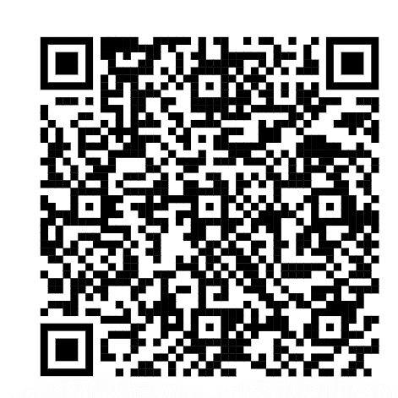
Project analysis slide 2
NAME
TEXT
R code is here

Slide 22
Project analysis slide 2
NAME
TEXT

Slide 23
Project analysis slide 2
NAME
TEXT

